Slide 1
DATA 201 · WEEK 8
Regularization and Model Complexity
Ridge · lasso · the bias–variance tradeoff · interpretability vs. flexibility
Fit
→
Overfit
→
Penalize
→
Tune α
→
Interpret
Prof. Alraee
Source: James, Witten, Hastie, Tibshirani & Taylor, An Introduction to Statistical Learning (ISLP), Ch. 6

Slide 2
From choosing a model to controlling its complexity
WHERE WE ARE
Weeks 6-7: what you already know
Overfitting and underfitting (Week 6)
Cross-validation and grid search to pick a hyperparameter
Scaling inside a Pipeline, fit on training data only (Week 7)
Logistic regression, LDA, QDA and KNN
Week 7 mentioned that L1 can shrink coefficients to zero. Today we see why.
This week: controlling complexity
Why plain least squares overfits when there are many features
Bias and variance trade off
Ridge (L2) and lasso (L1): add a penalty to the fit
Choosing the penalty strength α with cross-validation
Interpretability vs. flexibility: what we gain and give up
Background
Ridge & lasso
In practice
Quick check
Lab

Slide 3
PART 1
Background: why models overfit
Linear regression, too many features, and the bias–variance tradeoff

Slide 4
Linear regression: a weighted sum of features
PART 1 · BACKGROUND
prediction = b + w₁·x₁ + w₂·x₂ + … + wₚ·xₚ
Each weight (coefficient) says how much the prediction changes when that feature goes up by 1, with the others held fixed.
Fitting means choosing the weights. Least squares picks the ones that make the squared training errors (residuals) as small as possible.
Dots: training data Teal line: fitted model Orange dashes: residuals (errors)
Ordinary least squares tries to minimize training error, without penalizing model complexity. As a result, it may fit the training data too closely, including random noise, leading to overfitting and poor predictions on new data.

Slide 5
With many features, least squares overfits
PART 1 · BACKGROUND
What the simulation shows
Training error keeps falling toward 0 as features are added, because each additional feature gives the model more coefficients to adjust, making it more flexible.
With more coefficients, the model has more freedom to fit the training observations, including random noise. Adding useful features helps the model capture real relationships and make better predictions.
Adding unnecessary features allows the model to fit random noise rather than meaningful patterns. This is overfitting.
When the number of features approaches the number of observations: The model may fit the training data almost perfectly, but its coefficients can become extremely unstable, leading to very poor predictions on new data.
What do we want? keep all the features but stop the weights from getting wild.

Slide 6
Bias and variance: two ways a model can be wrong
PART 1 · BACKGROUND
Bias is the systematic error that occurs when a model is too simple to capture the true relationship in the data. (underfitting)
Variance measures how much a model's predictions would change if we trained it using a different sample of data. (overfitting)
Noise
Randomness we can never predict.
Test error ≈ bias² + variance + noise. We trade bias against variance.

Slide 7
Bias–variance in models you already know
PART 1 · BACKGROUND
KNN with large k
KNN with moderate k
KNN with k = 1
Model flexibility
Few features
A moderate number of features
Many features, high-degree polynomials
Too rigid: high bias, low variance
Too simple to capture the real pattern, so it misses on training and test data alike. Underfitting.
Too flexible: low bias, high variance
Follows the training data closely, noise included. A different sample gives a very different model. Overfitting.
Every hyperparameter you tuned in Week 6 was a bias–variance dial. Today’s new dial: the regularization strength α.

Slide 8
Interpretability vs. flexibility
PART 1 · BACKGROUND
Easier to explain → harder to explain, more flexible
Lasso
Ridge
Linear / logistic regression
LDA
QDA
KNN
Rough guide only: placement depends on the problem. Trees, ensembles and neural networks sit further to the right.
When interpretability matters
You must explain which features drive a prediction and by how much: medicine, lending, policy, science. Fewer features and stable coefficients help.
When flexibility matters
Only prediction accuracy counts, there is plenty of data, and the patterns are complicated. Explanation is secondary.
Regularization lets us keep an interpretable linear model and tune its flexibility: ridge stabilizes it, lasso also trims it.

Slide 9
PART 2
Ridge and lasso regression
Add a penalty for large coefficients

Slide 10
The big idea: fit the data, but pay for complexity
PART 2 · RIDGE AND LASSO
Training error: how wrong are we on the training data?
+
α × Penalty: how large are the coefficients?
=
What the model minimizes
α = 0
No penalty: ordinary least squares. Can overfit when there are many features.
Moderate α
Coefficients shrink a little. Variance drops a lot, bias rises a little. Usually the best choice.
Very large α
Coefficients are pushed to 0 and the model predicts roughly the average. Underfitting.
Naming: ISLP writes λ (lambda). scikit-learn calls the same quantity alpha (α).
We accept a little bias to buy a lot less variance. This is called shrinkage.
Ordinary linear regression only tries to minimize the errors in the training data. Ridge and Lasso still want small errors, but they also penalize large coefficients. Ridge squares the coefficients, while Lasso takes their absolute values. Lambda controls how much we care about that penalty. As lambda increases, we restrict the model more, which may reduce overfitting. OLS minimizes training error. Ridge and Lasso balance training error against model complexity.

Slide 11
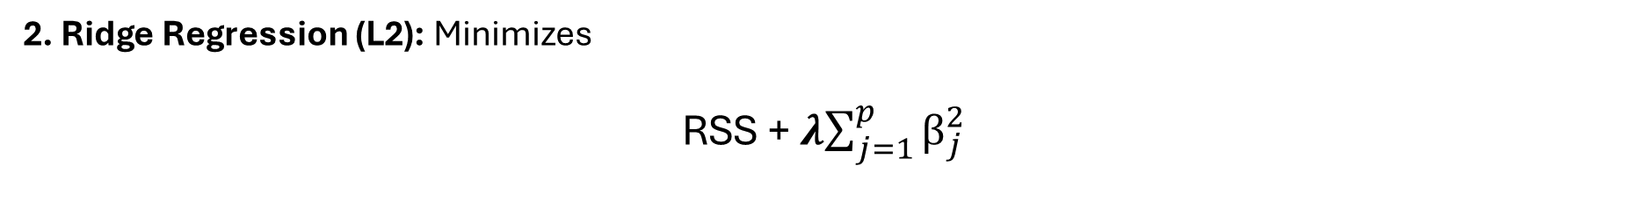
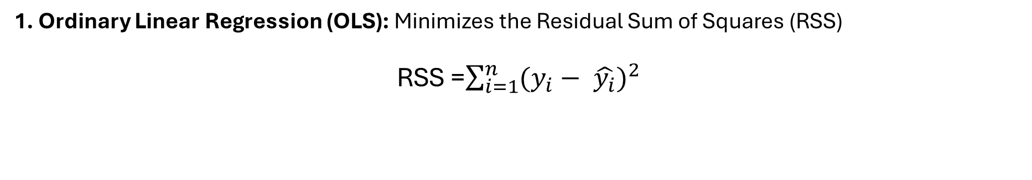
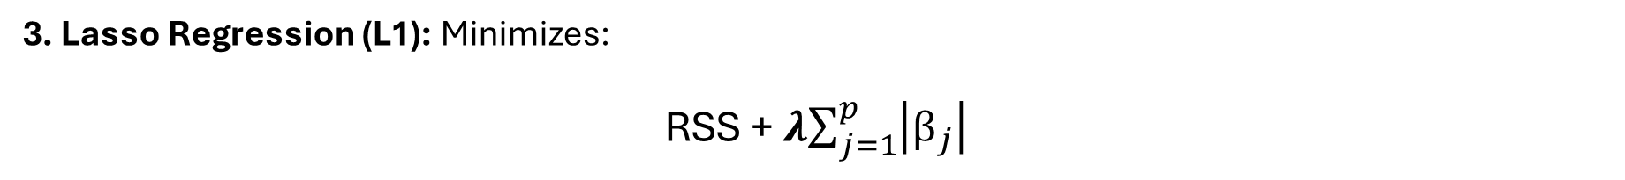
How do Linear Regression, Ridge, and Lasso minimize error?
1. Ordinary Linear Regression (OLS): Minimizes the Residual Sum of Squares (RSS)
RSS =$\sum_{i=1}^{n}{{(y_{i}− \hat{y_{i}})}^{2}}$
OLS finds the coefficients that minimize the total squared prediction errors on the training data.
2. Ridge Regression (L2): Minimizes
RSS + 𝝀$\sum_{j=1}^{p}{β_{j}^{2}}$
Training error + penalty on squared coefficients. Ridge discourages large coefficients, shrinking them toward zero.
3. Lasso Regression (L1): Minimizes:
RSS + 𝝀$\sum_{j=1}^{p}{\left|β_{j}\right|}$
Training error + penalty on absolute coefficients. Lasso shrinks coefficients and can set some exactly to zero, removing predictors from the model.

Slide 12
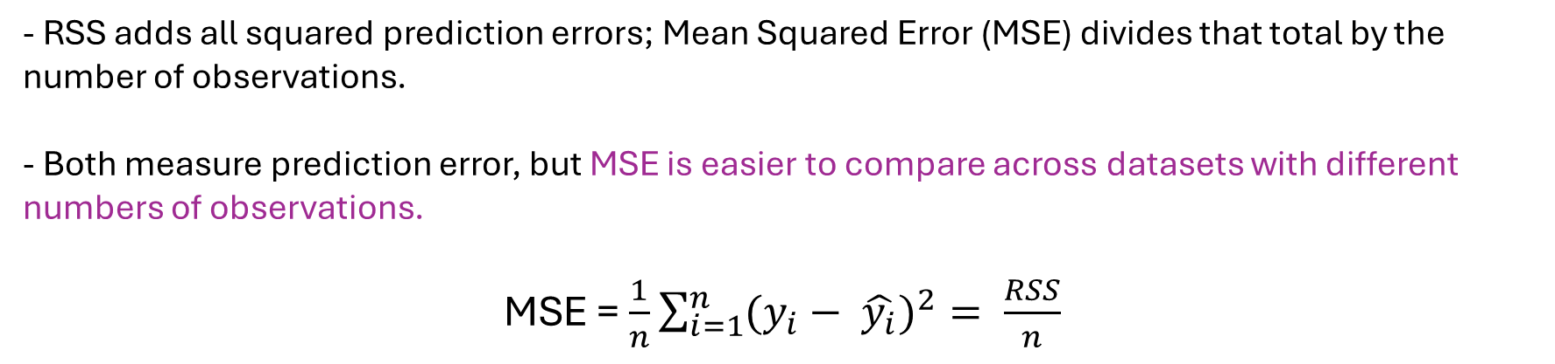
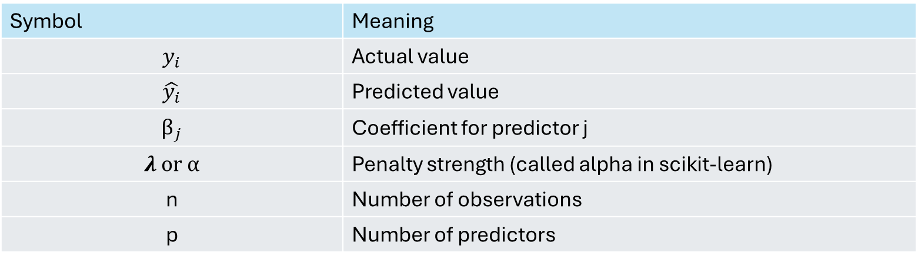
How do Linear Regression, Ridge, and Lasso minimize error?
Symbol | Meaning
$$y_{i}$$ | Actual value
$$\hat{y_{i}}$$ | Predicted value
$$β_{j}$$ | Coefficient for predictor j
𝝀 or α | Penalty strength (called alpha in scikit-learn)
n | Number of observations
p | Number of predictors
- RSS adds all squared prediction errors; Mean Squared Error (MSE) divides that total by the number of observations.
- Both measure prediction error, but MSE is easier to compare across datasets with different numbers of observations.
MSE = $\frac{1}{n}$ $\sum_{i=1}^{n}{{(y_{i}− \hat{y_{i}})}^{2}}= \frac{RSS}{n}$

Slide 13
Ridge regression (L2 penalty)
PART 2 · RIDGE AND LASSO
Penalty: the sum of the squared coefficients
Big coefficients are punished the most
Shrinks every coefficient toward 0, smoothly
No coefficient becomes exactly 0: every feature stays
Correlated features share the weight instead of fighting
Works well when many features each matter a little
Least squares (illustrative)
x₁
x₂
x₃
x₄
x₅
Ridge: every bar shrinks, none hits 0
from sklearn.linear_model import Ridge
model = Ridge(alpha=1.0)
x₁
x₂
x₃
x₄
x₅
Larger alpha = stronger shrinkage.

Slide 14
Ridge in action: coefficients shrink as α grows
PART 2 · RIDGE AND LASSO
Reading the paths
442 patients, 10 standardized predictors. The goal is to predict disease progression after one year.
Small α (left side): Little regularization. Coefficients are close to those from ordinary linear regression.
Increasing α (moving right): Ridge generally shrinks coefficients toward zero, reducing their overall magnitude.
Correlated predictors (s1 and s2): These blood measurements are strongly correlated (r = 0.90). Ordinary linear regression assigns them large, opposite coefficients (−38 and +23), which can be unstable.
Ridge's effect: As α increases, Ridge reduces these extreme coefficients, making the model less sensitive to overlapping information.

Slide 15
Lasso regression (L1 penalty)
PART 2 · RIDGE AND LASSO
Penalty: the sum of the absolute values of the coefficients
Shrinks coefficients and sets some exactly to 0
That is automatic feature selection: a sparse model
Best when only a few features really matter
With correlated features it tends to keep one and drop the rest
A removed predictor is not necessarily unimportant. Its information may overlap with another predictor that Lasso kept.
Least squares (illustrative)
x₁
x₂
x₃
x₄
x₅
Lasso: small ones drop to exactly 0
0
0
from sklearn.linear_model import Lasso
model = Lasso(alpha=1.0)
x₁
x₂
x₃
x₄
x₅
Same alpha idea: larger alpha = stronger penalty.
Notes:
The key behavior: some coefficients land exactly on zero, so lasso doubles as feature selection (this is the L1 behavior behind SelectFromModel in Week 7).

Slide 16
Lasso in action: features drop out one by one
PART 2 · RIDGE AND LASSO
Reading the paths
Lines now hit 0 and stay there.
At α = 1, 3 of 10 features are already exactly 0 (age, s2, s4).
At α = 5, 5 are gone. At α = 20 only 3 remain (bmi, bp, s5).
The strongest signals (bmi, s5) survive longest.
Caution: with correlated features the ranking can be fragile (we return to this).

Slide 17
Why does lasso give exact zeros?
PART 2 · RIDGE AND LASSO
How to read it
Purple shaded region: The allowed values of the coefficients under the regularization constraint (penalty budget).
Black dot: The best coefficients from ordinary linear regression (OLS) without a penalty.
Orange ellipses: Lines of equal training error (RSS). Ellipses closer to the black dot represent lower error.
Blue dot: The best solution with regularization, where the lowest-error ellipse first touches the allowed region.
Lasso (diamond): The blue dot often falls at a corner on an axis, making one coefficient exactly zero and eliminating that predictor.
Ridge (circle): The smooth boundary generally leads to smaller but nonzero coefficients, keeping both predictors.
Lasso: diamond
Ridge: circle
β₂
β₂
β₁
β₁
Touches at a corner on the axis: β₁ = 0
Touches off the axis: both non-zero
Corners give lasso exact zeros. The round ridge region only shrinks.

Slide 18
Ridge vs. lasso: which one, when?
PART 2 · RIDGE AND LASSO
 | Ridge (L2) | Lasso (L1)
Penalty on | Sum of squared coefficients | Sum of absolute coefficients
Coefficients | Small, never exactly 0 | Some exactly 0
Feature selection | No: keeps every feature | Yes: automatic
Correlated features | Shares weight among them | Often keeps one, drops the others
Works best when | Many features each matter a little | Few features matter, the rest do not
scikit-learn | Ridge, RidgeCV or GridSearchCV | Lasso, LassoCV or GridSearchCV
No universal winner: try both and let cross-validation decide.
Beyond the chapter: Elastic Net (ElasticNet in scikit-learn) blends both penalties, handy with groups of correlated features.

Slide 19
PART 3
Regularization in practice
Scaling, choosing α, and reading the results

Slide 20
Scale first: the penalty is blind to units
PART 3 · IN PRACTICE
Income in dollars
Suppose the regression coefficient is 0.002.
This means a $1 increase in income changes the predicted outcome by 0.002 units.
Because the coefficient is very small, Ridge and Lasso apply a relatively small penalty.
Income in thousands of dollars
The same income is now expressed in thousands rather than dollars.
The coefficient becomes 2, meaning a $1,000 increase changes the predicted outcome by 2 units.
Because the coefficient is much larger, Ridge and Lasso apply a much larger penalty.
What to do
Why scale? Ridge and Lasso penalize coefficient magnitudes, which depend on the units used to measure predictors.
Standardize numerical predictors: Convert them to a mean of 0 and a standard deviation of 1.
Use a Pipeline: Place StandardScaler() inside the pipeline so scaling is calculated separately using the training observations in each cross-validation fold.
Tree-based models: Generally do not require scaling because they make splits based on predictor values rather than penalizing coefficients.
make_pipeline(
StandardScaler(),
Ridge(alpha=1.0))
Week 7 rule: anything that learns from data is fit on training data only.

Slide 21
Choosing α with cross-validation
PART 3 · IN PRACTICE
RidgeCV(alphas=np.logspace(-2, 3, 50), cv=5)
LassoCV(cv=5)
Plain least squares scores about 2978; the best ridge and lasso about 2974 and 2972. A tiny gain: with 442 rows and 10 features, least squares is already stable.
Regularization does not always produce large improvements, especially when ordinary linear regression is already stable.

Slide 22
When it pays off: many features, few rows
PART 3 · IN PRACTICE
Setup
Simulated: 50 training rows, 45 features. Two scenarios.
Least squares overfits badly in both cases.
Lasso wins when few features matter (it also drops features).
Ridge wins when many matter a little.
Caution: CV-chosen lasso kept about 20 features on average, not just 5 in the first scenario.
Regularization matters most when features are close to or outnumber the rows.

Slide 23
α is the bias–variance dial
PART 3 · IN PRACTICE
α too small
Variance 29, bias² about 0. Test error 33.5. Overfit.
α too large
Bias² 16, variance near 0. Test error 20.7. Underfit.
Sweet spot: α ≈ 10
Test error 12.1, a third of no penalty.
Raising α trades variance for bias. Cross-validation finds the balance.

Slide 24
Interpretation: what do the coefficients say?
PART 3 · IN PRACTICE
Lasso keeps 8 of 10
age and s2 are exactly 0.
s1 and s2: least squares gives −38 and +23, ridge −28 and +15, lasso −6 and 0.
Caution
Zero is not “unimportant” and non-zero is not “causal”.
Ridge calms the unstable pair. Lasso simplifies the model.

Slide 25
Regularization for classification: logistic regression
PART 3 · IN PRACTICE · BEYOND THE CHAPTER
C | L2 features | L1 features
0.001 | 30 | 0
0.01 | 30 | 2
0.1 | 30 | 7
1 | 30 | 14
10 | 30 | 21
100 | 30 | 25
Non-zero coefficients out of 30. L2 never zeroes any; L1 does.
C = 1: L1 keeps 14 of 30 features and matches L2’s 95.8% in the graph.
Regularization also works for classification. L1 can simplify logistic regression by removing predictors, sometimes without sacrificing accuracy. In logistic regression, regularization strength is controlled by C, which works in the opposite direction of α: smaller C means stronger regularization

Slide 26
Other roads in the chapter (a short tour)
PART 3 · IN PRACTICE
1
Subset selection
2
Dimension reduction
3
Information criteria
Search for the best subset of features. Best subset tries every combination: 20 features means 1,048,576 models.
Forward and backward stepwise are greedy shortcuts. Week 7’s RFE is a cousin.
Replace the features with a few combinations of them (PCR), then fit least squares.
PCR builds the combinations from X alone.
Cp, AIC, BIC and adjusted R² adjust training error for the number of features to estimate test error.
Cross-validation is usually simpler and more general.
In practice, regularized models tuned by cross-validation are the usual starting point.

Slide 27
A practical recipe
PART 3 · IN PRACTICE
1 Split
2 Scale
3 Fit with CV
4 Compare
5 Inspect
6 Test once
from sklearn.pipeline import make_pipeline
from sklearn.preprocessing import StandardScaler
from sklearn.linear_model import LassoCV
model = make_pipeline(StandardScaler(),
LassoCV(cv=5))
model.fit(X_train, y_train)
model.score(X_test, y_test) # test R²
model[1].alpha_ # chosen alpha
model[1].coef_ # zeros = dropped
What to report
The chosen α and how you chose it (5-fold CV)
Test error next to a plain least squares baseline
Number of non-zero coefficients (lasso)
The largest standardized coefficients
Same discipline as Week 7: everything learned from data stays inside the pipeline.

Slide 28
Pitfalls to avoid
PART 3 · IN PRACTICE
1
Forgetting to scale
2
Tuning α on the test set
3
Reading zeros as “unimportant”
Unscaled features are penalized unevenly. Standardize inside a Pipeline.
Pick α by cross-validation on training data. Touch the test set once. (data leakage!!)
Correlated features can swap places and α changes who survives. Selection is not causation. (interpretation)
4
Mixing up the names
5
Judging by training error
6
Regularization Does Not Always Improve Performance
ISLP’s λ is scikit-learn’s alpha. In LogisticRegression, C is the inverse: small C = strong penalty.
A penalized fit always looks worse on training data. Compare on test or CV error.
With many rows and few features, plain least squares is already stable (our diabetes example).

Slide 29
Which approach, and why?
QUICK CHECK · DISCUSS IN PAIRS
A
Scenario A
B
Scenario B
30 patients, 500 gene measurements. Goal: shortlist a few genes for follow-up. Which penalty?
5,000 customers, 25 strongly correlated features. Goal: best predictions; every feature is cheap to keep. Which penalty?
C
Scenario C
D
Scenario D
10,000 rows, 3 features, a roughly linear relationship. Will ridge or lasso help much?
Lasso sets age to exactly 0. Can we say age does not matter?

Slide 30
Key takeaways
SUMMARY
Overfitting is variance. Underfitting is bias.
The strength α trades one for the other.
Ridge shrinks. Lasso shrinks and selects.
L2 keeps every feature; L1 sets some to exactly 0.
Scale, then tune α with cross-validation.
Use a Pipeline so scaling is learned from training folds only.
Simpler can be better.
A little bias buys a lot less variance, and a model that is easier to explain.
Next: hands-on lab

